Slide 1
MOLECULAR BIOLOGY LABORATORY
BT 453
Laboratory No. 5
PCR II
MBL. BT453

Slide 2
Things might need optimization
Template DNA
  Quality
  Quantity
Reaction components
  Reaction Buffer: Salt concentration (KCl)
  MgCl₂ concentration
  dNTPS concentration
  Primers
    Concentration
    Design
  DNA Polymerase
Reaction conditions
  The denaturing, annealing and extension temperature.
  The denaturing, annealing and extension times.
  PCR variation (touch down PCR, nested PCR, . . . Ect)

Slide 3
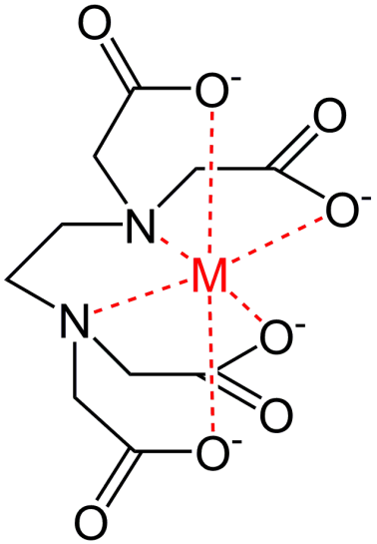


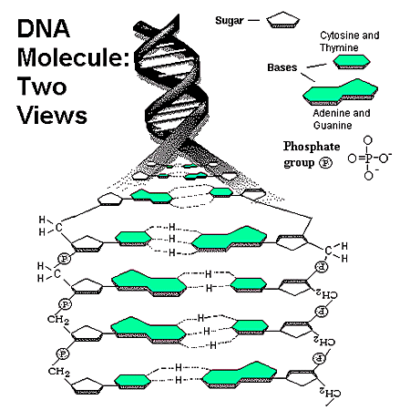
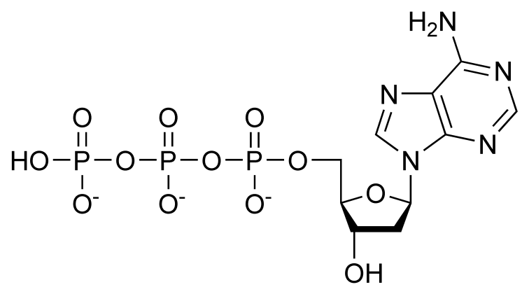
Reaction components / MgCl₂ Concentration
EDTA
Proteins
Proteins
DNA Polymerase
Mg⁺²
Mg⁺²
Mg⁺²
Mg⁺²
Mg⁺²
dNTP

Slide 4
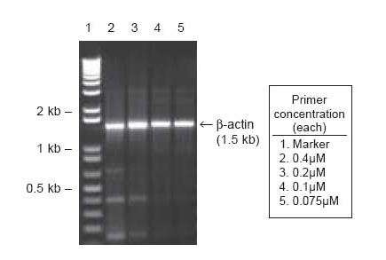
Reaction components / Primers Concentration
Primer concentration in a common PCR reaction is about 0.1-1 µM per primer.
Increasing primer concentration may improve the outcome of the PCR reaction and should be considered as a way to optimize PCR reactions.
High primer concentrations may promote mispriming and accumulation of nonspecific product and may increase the probability of generating a template-independent artifact termed a primer-dimer.
Nonspecific products and primer-dimer artifacts are themselves substrates for PCR and compete with the desired product for enzyme, dNTPs, and primers, resulting in a lower yield of the desired product.
Specific amplification
Non-specific amplification
Primer Dimer

Slide 5
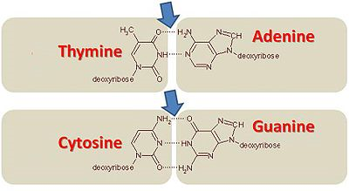
Reaction components / Primers design
Length | 18 to 30 nucleotides
GC Content | 40% to 60%
Melting & Annealing Temperatures | Generally a Tm between 55° and 80°C will yield the best results For annealing temperature, use 5°C to 10°C below melting temperature (Tm)
Sequence | + Avoid multiple sequences (3 or more) Gs and Cs at the 3’ end + Avoid mismatches at the 3’ end + Avoid complementary sequences within the primer + Avoid primer–dimer formation by complementarity at 3’ ends of primer pairs

Slide 6
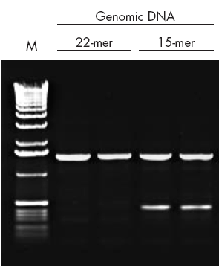
Primers design / Length
Primer length determines the specificity and significantly affect its annealing to the template
  Too short -- low specificity, resulting in non-specific amplification
  Too long -- decrease the template-binding efficiency at normal annealing temperature due to the higher probability of forming secondary structures such as hairpins.
Optimal primer length
  18-24 bp for general applications
  30-35 bp for multiplex PCR
Optimal amplicon size
  300-1000 bp for general application, avoid > 3 kb
  50-150 bp for real-time PCR, avoid > 400 bp
Non-specific amplification

Slide 7
Primers design / Melting Temperature (Tm)
Melting temperature (T_{m}):
The temperature at which 50% of the DNA duplex dissociates to become single stranded
  Determined by primer length, base composition and concentration.
  Also affected by the salt concentration of the PCR reaction mix
Melting temperature (T_{m}) calculations
T_{m}=2(A+T)+4(G+C)
  Suitable only for 18 base or shorter primers
T_{m} = 81.5 + 16.6 × (log₁₀[Na⁺]) + 0.41 × (%G+C) – 675/n
  Suitable primers containing more than 18 base
  [Na⁺] is the molar salt concentration and n = number of bases in the oligonucleotide

Slide 8
Primers design / Melting Temperature (Tm)
Optimal melting temperature
  Between 52°C-- 65°C
  Tm above 65°C should be generally avoided because of the potential for secondary annealing.
  Higher Tm (75°C-- 80°C) is recommended for amplifying high GC content targets.
Primer pair Tm mismatch
  Significant primer pair Tm mismatch can lead to poor amplification
  Desirable Tm difference < 5°C between the primer pair

Slide 9
Primers design / GC content, repeats and runs
Primer G/C content
  Optimal G/C content: 45-55%
  Common G/C content range: 40-60%
  If G/C content is less than 50%, extend the primer sequence beyond 18 bases (melting temperature above the limit of 50ºC).
Runs (single base stretches)
  Long runs increases mis-priming (non-specific annealing) potential
  The maximum acceptable number of runs is 4 bp
Repeats (consecutive di-nucleotide)
  Repeats increases mis-priming potential
  The maximum acceptable number of repeats is 4 di-nucleotide
5’ CGATGCTAGACTGATGCAGTA 3’
5’ CGATGCTACCCCCGATGGGGC 3’
5’ CGATGCTATATATAGATGGGGC 3’

Slide 10
Primers design / Specificity
Specificity
  Determined primarily by primer length AND sequence
Cross homology
  Cross homology may become a problem when PCR template is genomic DNA or consists of mixed gene fragments.
  Primers containing highly repetitive sequence are prone to generate non-specific amplicons when amplifying genomic DNA.
Avoid non-specific amplification
  BLASTing PCR primers against NCBI non-redundant sequence database is a common way to avoid designing primers that may amplify non-targeted homologous regions.

Slide 11
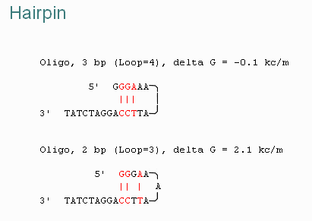
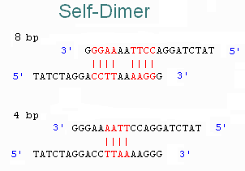
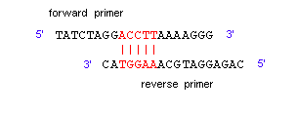
Primers design / Primer secondary structures
Hairpins
  Formed via intra-molecular interactions
  Negatively affect primer-template binding, leading to poor or no amplification
Self-Dimer (homodimer)
  Formed by inter-molecular interactions between the two same primers
Cross-Dimer (heterodimer)
  Formed by inter-molecular interactions between the sense and antisense primers
Hairpin
Self-Dimer
Cross-Dimer

Slide 12
Primers design / Specificity
GC clamp
  Refers to the presence of G or C within the last 4 bases from the 3’ end of primers
  Essential for preventing mis-priming and enhancing specific primer-template binding
5’ CGATGCGGTAGATCGATGCGGC 3’

Slide 13
When is a “primer” a primer?
5’
3’
Specific amplification
5’
3’
Non-specific amplification
5’
3’
Non-specific amplification
3’
5’
No amplification

Slide 14
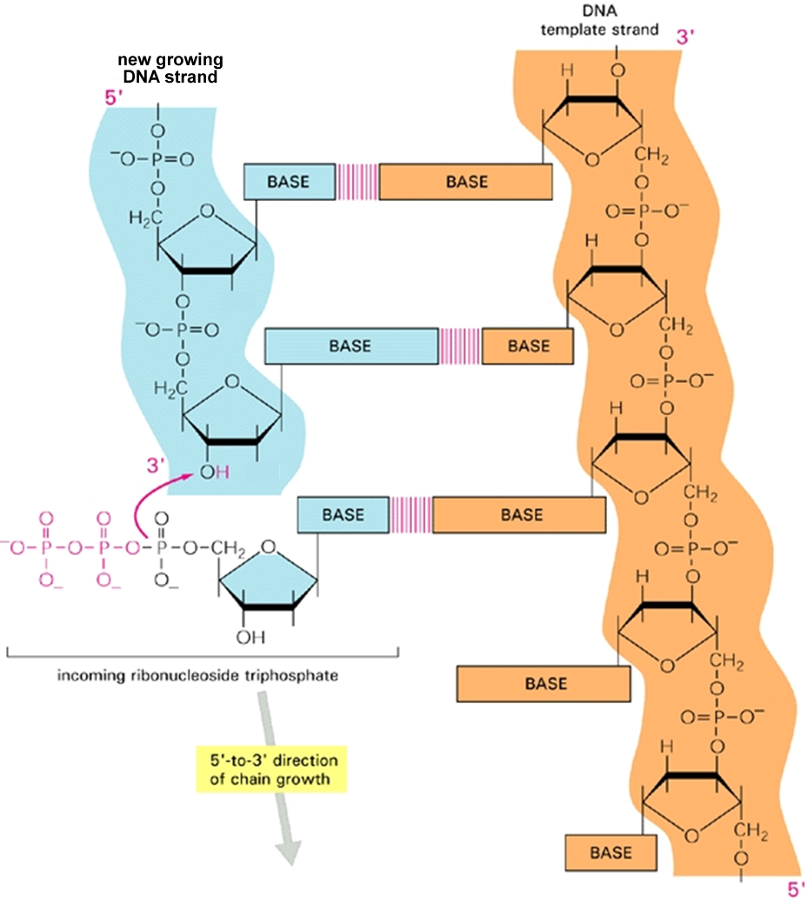
Hydrogen bonds
Primer
DNA strand
Incorporated nucleotide
Free OH

Slide 15
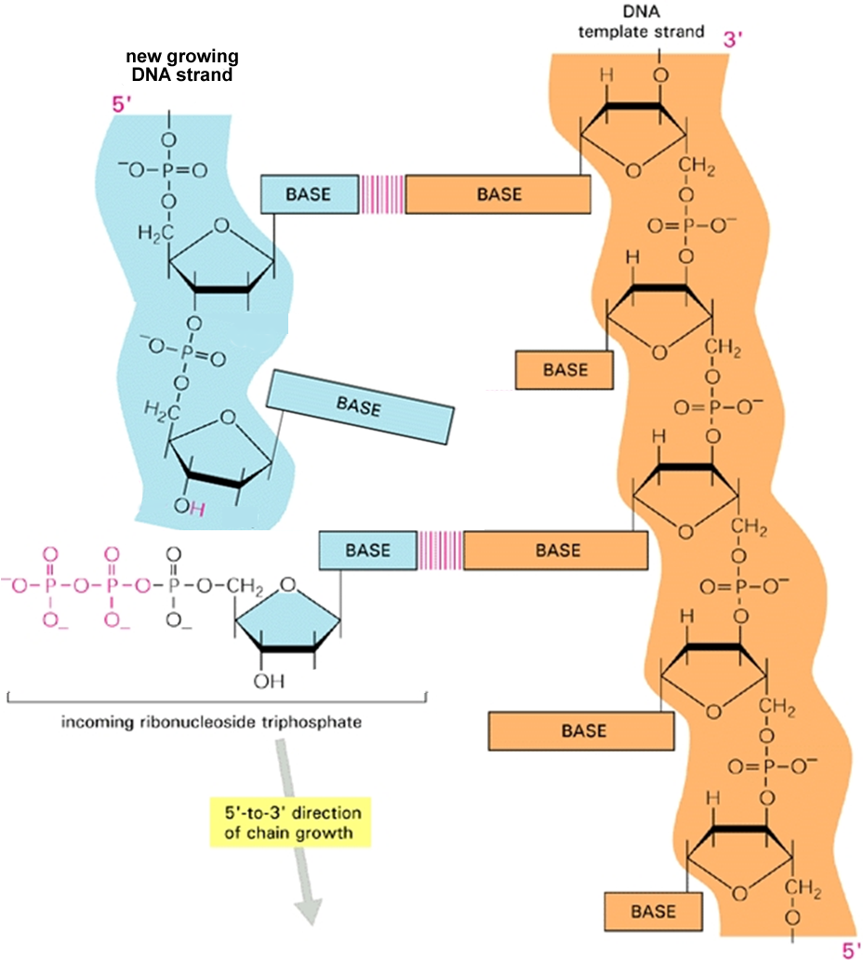
Hydrogen bonds
Primer
DNA strand
Unincorporated nucleotide
Free OH

